Slide 1
Team K – TrackStats

Slide 2
Main Objectives?
A functional website
Allowing users to see their own fitness data from the most common perspectives
Easy adapting application
Allow people access their own data

Slide 3
DEMO

Slide 4
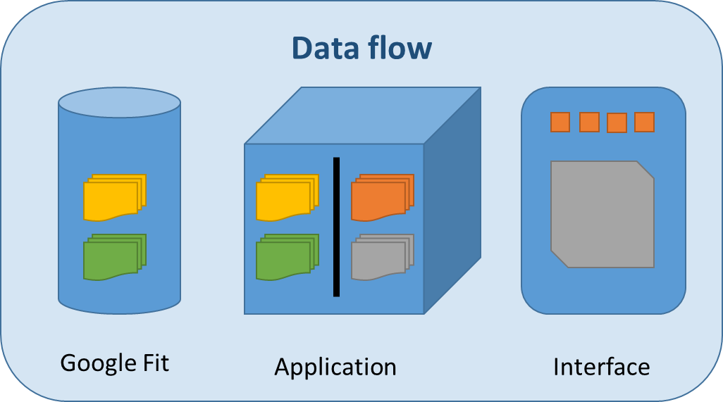
Architecture

Slide 5
Frameworks & Libraries

Slide 6
CLOUD SERVICES

Slide 7
Potential developments
Advanced features

